Slide 1
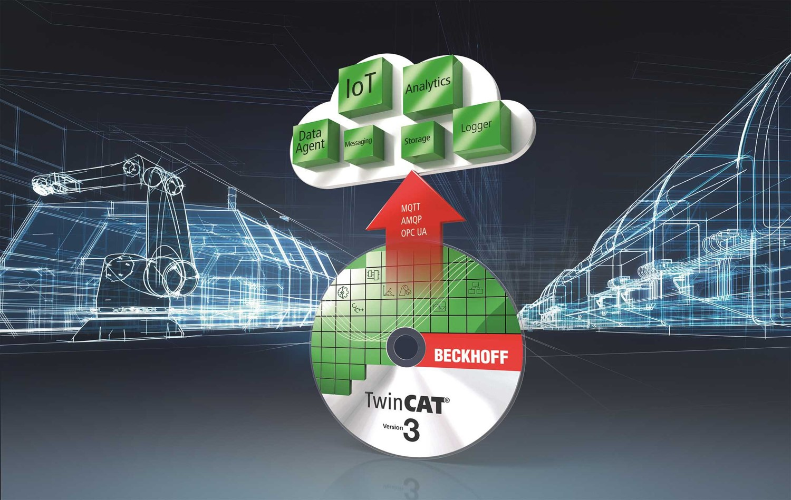
Engineering Meeting 2024 TwinCAT 3 Analytics
Presenter: Alyssa Hiedeman
PM: Brandon Stiffler

Slide 2
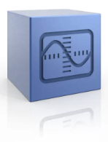



TwinCAT 3 | Analytics Story
Comprehensive, scalable solution for collecting, aggregating, and analyzing automation system data.
High resolution, real-time data acquisition
Distributed connectivity and data storage architecture
Extensive library of no-code analysis algorithms
Drag & drop interface
Scope integration
Exportable runtimes for 24/7 analysis
PLC code generation
HMI dashboard generation
Troubleshooting
Diagnostics
Race Conditions
Energy Efficiency
Statistics
Data Logging
Optimization
Trending
Process Improvements
Predictive Maintenance
OEE
Performance
Cycle Time
Reliability
Quality Control
Dashboards

Slide 3
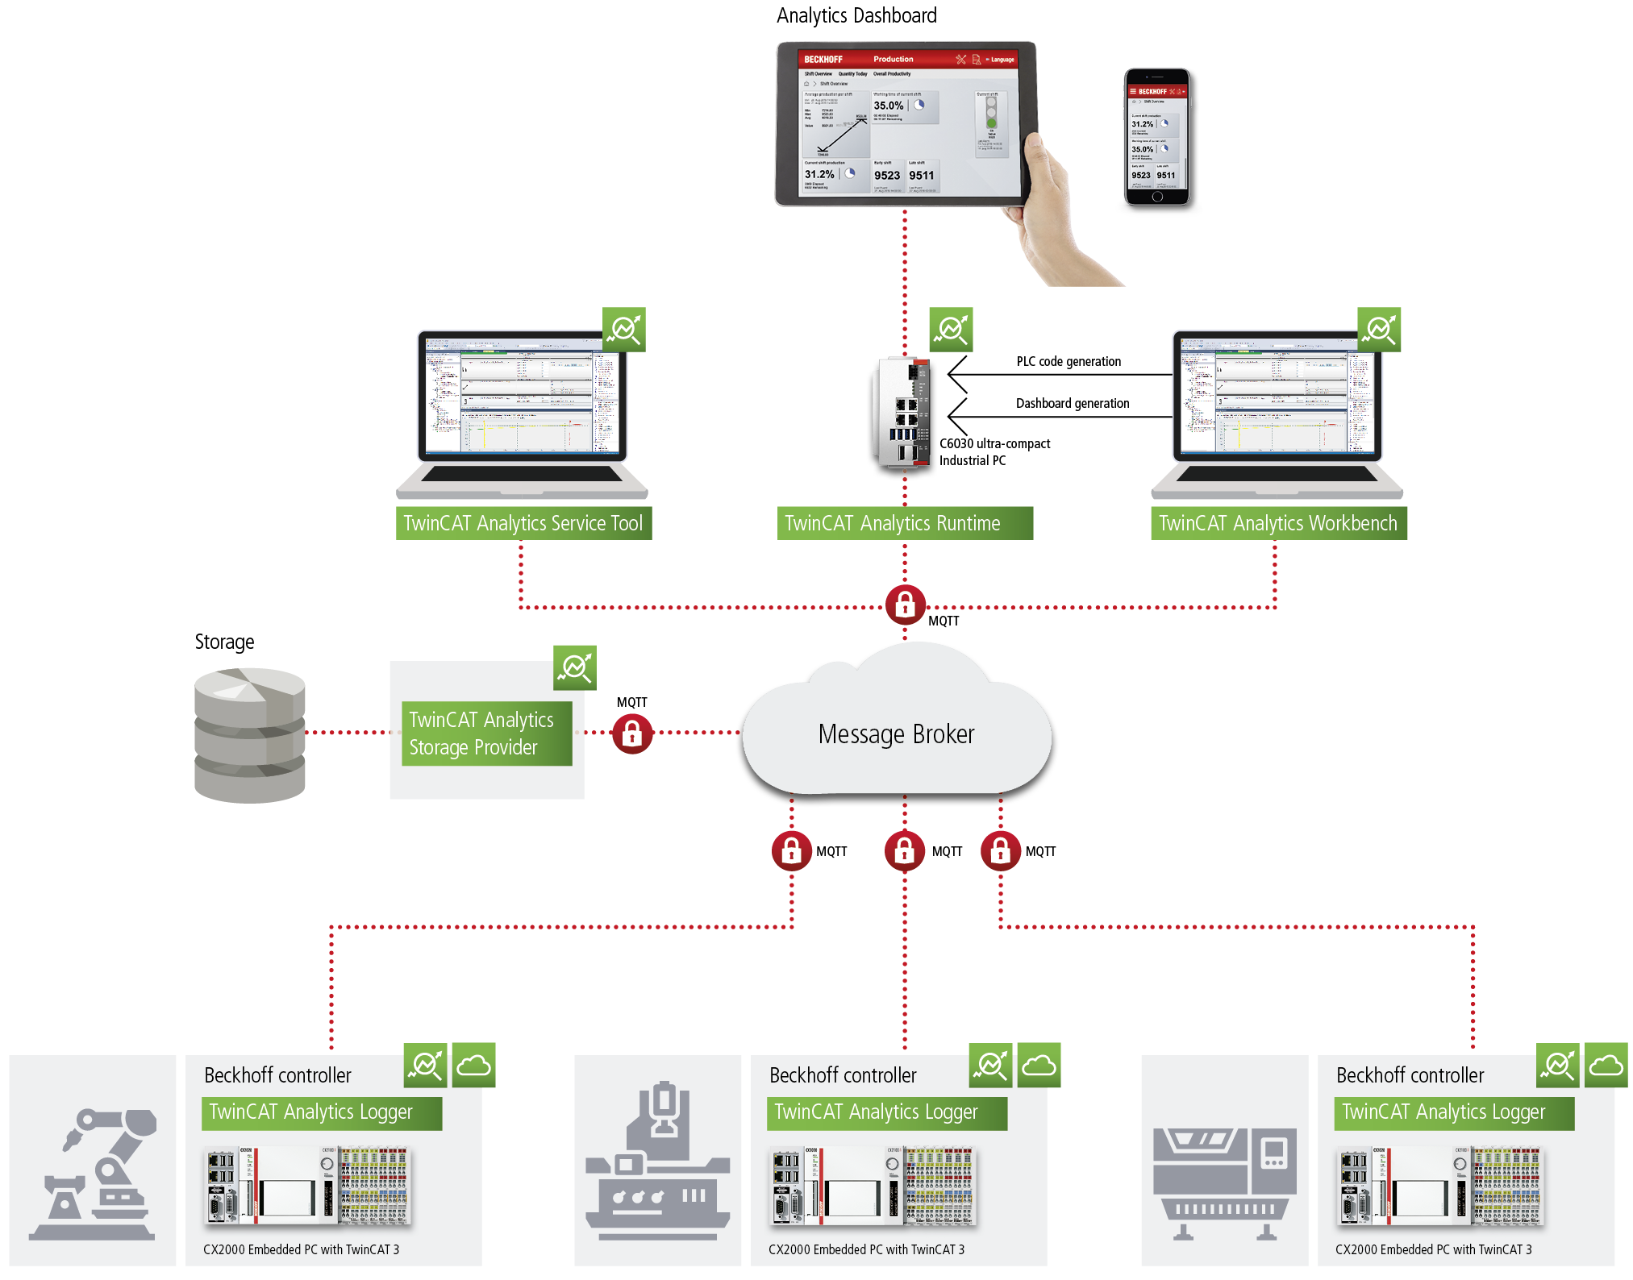
TwinCAT 3 | Analytics Workflow
Full Workflow
TwinCAT Runtime(s)
Optionally with Logger
Analytics Workbench
Analytics Storage Provider
Extra storage PC
Analytics Runtime
Client targets
Collection of licenses
MQTT(S) Broker
Centralized / cloud-based server

Slide 4
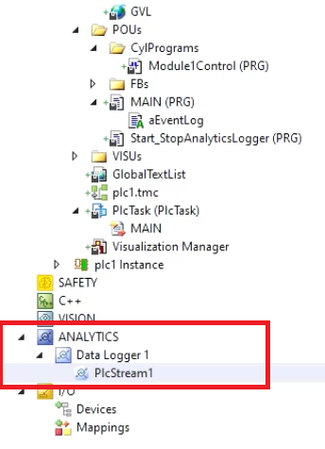
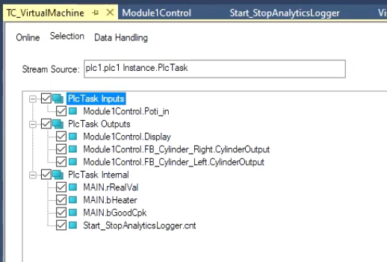
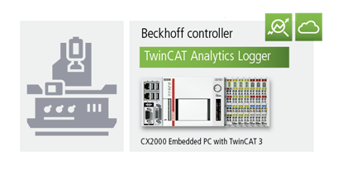


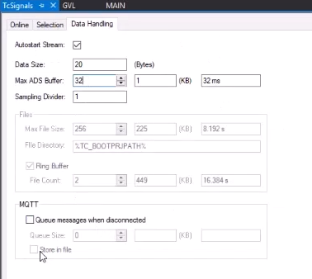

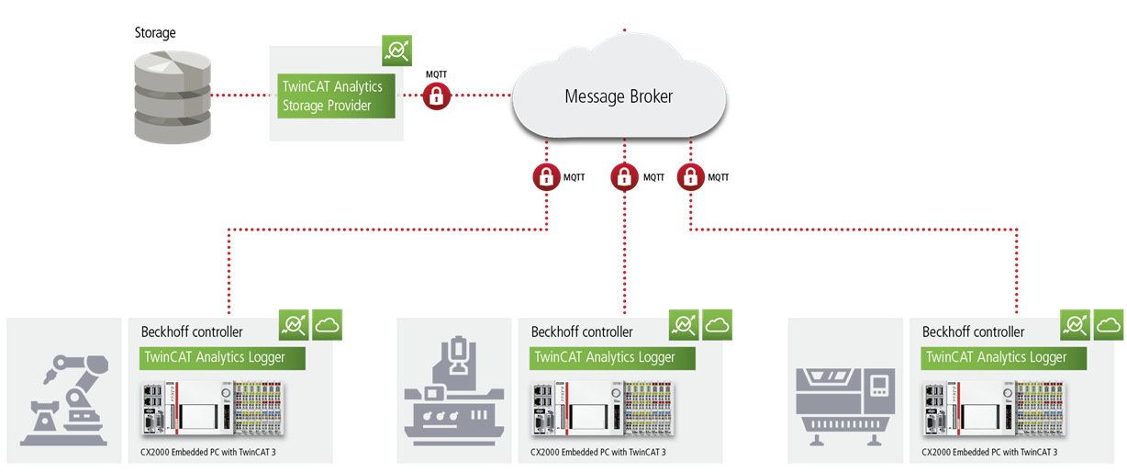

TwinCAT 3 | Analytics Data Acquisition
Notes:
Analytics Logger is a simple to use, flexible and cost-effective data acquisition solution
Acquisition should be comprehensive and scalable, but also straight-forward
As you’d expect, all setup and configuration is handled from within Visual Studio
Simply select the PLC symbols you’d like to log, and choose a basic data storage scheme
E.g. ring buffer or log indefinitely
Tool estimates size of output data
Supports logging to a local binary file, or to a remote target using MQTT
Analytics Storage Provider can aggregate multiple sources into one data store
Storage Provider updates* – more refined data retention policies (hot, warm, cold storage)
High resolution hot
Processed to lower resolution but longer lasting warm
Processed yet again to lower resolution, longest lasting cold

Slide 5
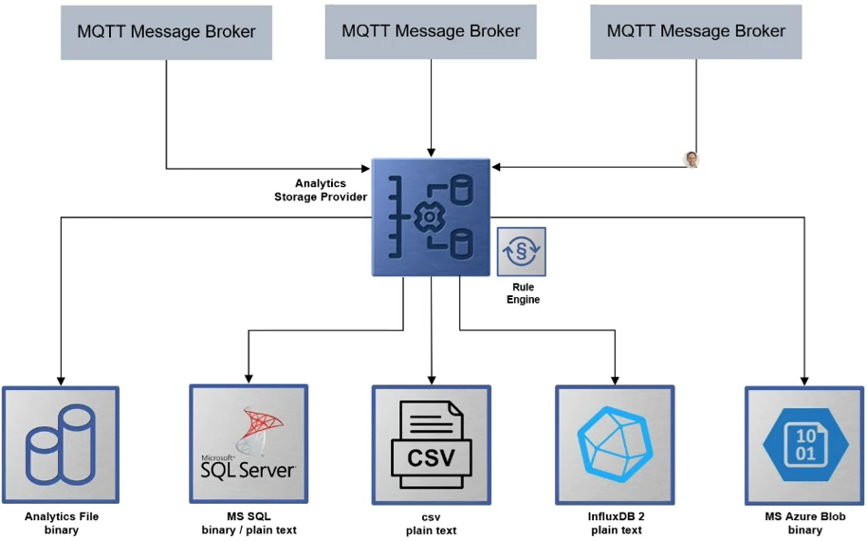
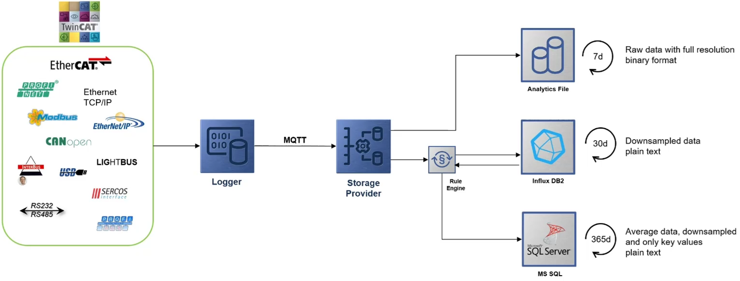
TwinCAT 3 | Analytics Storage Provider Updates
Removing dependency on proprietary binary data format
Plain text output / export
Configure data retention policy
Subscribe to multiple brokers, write to multiple stores
Future: Data retention policies
Notes:
Proprietary binary format a turn-off for many customers
They already have analysis or visualization solutions; just need the logging
**But remember that our Analytics solution is
Not just a logger
Not just high-level analysis (like overall equipment effectiveness)
It’s that, plus…

Slide 6
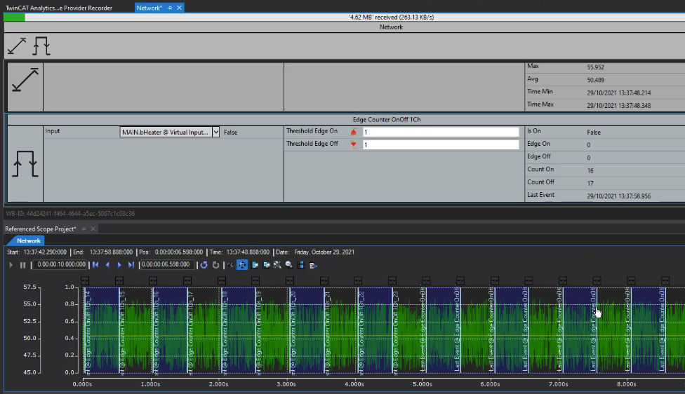
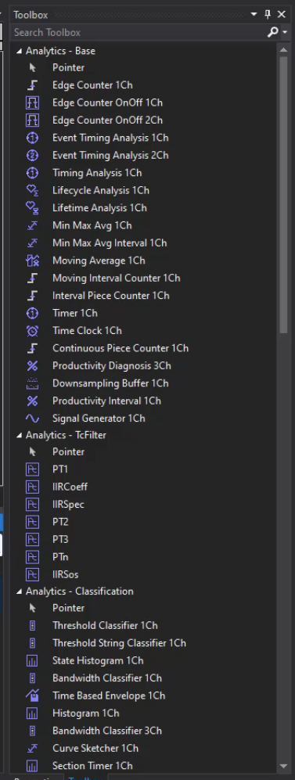
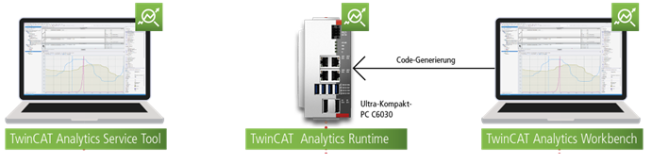
TwinCAT 3 | Analytics Engineering Tools
90+ Analysis Algorithms
Threshold monitoring
Counting
Timing analysis: total, min, max, avg
Lifetime monitoring
Logic Operators
RMS calculation
State Analysis
Energy calculation
OEE
Combine algorithms into parameterized templates
Scope integration
Create custom algorithms
PLC and dashboard code generation
Notes:
Large library of drag & drop algorithms for analysis
Post-processing our real-time or historical data via no-code drag & drop algorithms
Algorithms can be chained together, combined and parameterized into templates
Modularize analysis functions, similar to using FBs, AOIs in the PLC
If that’s not enough, you can implement your own analysis code via custom algorithm development in C++
Scope can be used on the output from the algorithms
Trend the results alongside the raw inputs
PLC and dashboard code generation:
The Analytics project can be published to a standalone runtime that performs the analyses 24/7 in its own PLC runtime
The runtime also hosts a web-based dashboard

Slide 7
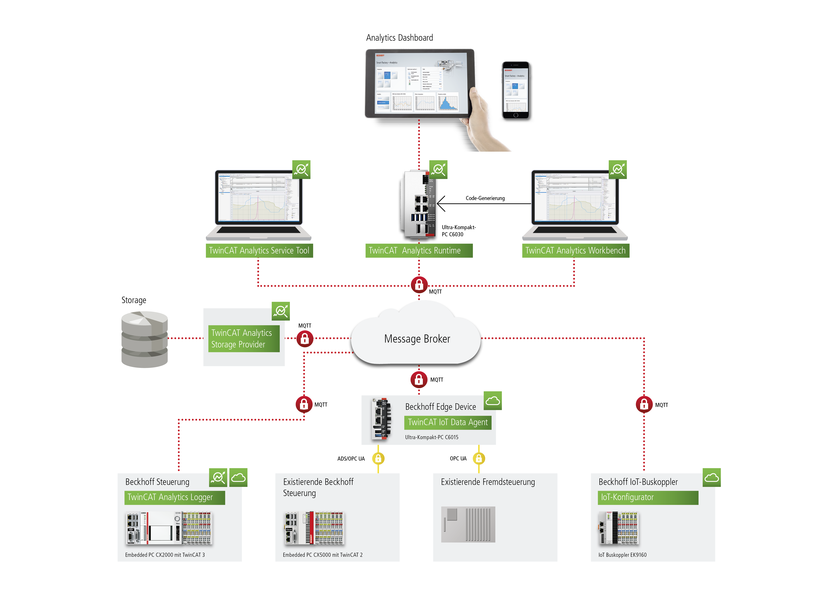
TwinCAT Analytics: Overview
Data Acquisition
Remote Connectivity
Engineering Tools, “Scope++”
24/7 Analysis, Dashboards
Notes:
Data acquisition / remote connectivity
Keep in mind we also have solutions to integrate third party controllers via all of our connectivity options
Industrial protocol bus couplers and functions (EIP, CAN, MB, etc)
IoT coupler and functions
OPC UA
Serialization/Deserialization methods for JSON, XML

